Slide 1



The F# Path to Data Scripting Nirvana
Tomas Petricek, .NET MVP (F#), fsharpWorks
Isaac Abraham, .NET MVP, (C#), elastacloud

Slide 2
TL;DL – What You Will Learn Today
…learn about F# as a technology and ecosystem
…learn the magic of Azure scale F# data scripting with MBrace
…learn about F# projects and F# scripting in Visual Studio
…learn the magic of FSharp.Data

Slide 3
libraries and tools mac & linux teaching F# user groups snippets consulting and training tutorials
F# Software Foundation
open-source community Xamarin Studio
http://www.fsharp.org
contributions research non-profit cross-platform testimonials

Slide 4
What we have seen
F# in Visual Studio with PowerTools
REPL
Also, JSON.NET, WebClient
F# Data for REST data access
This is easy, do it now!

Slide 5
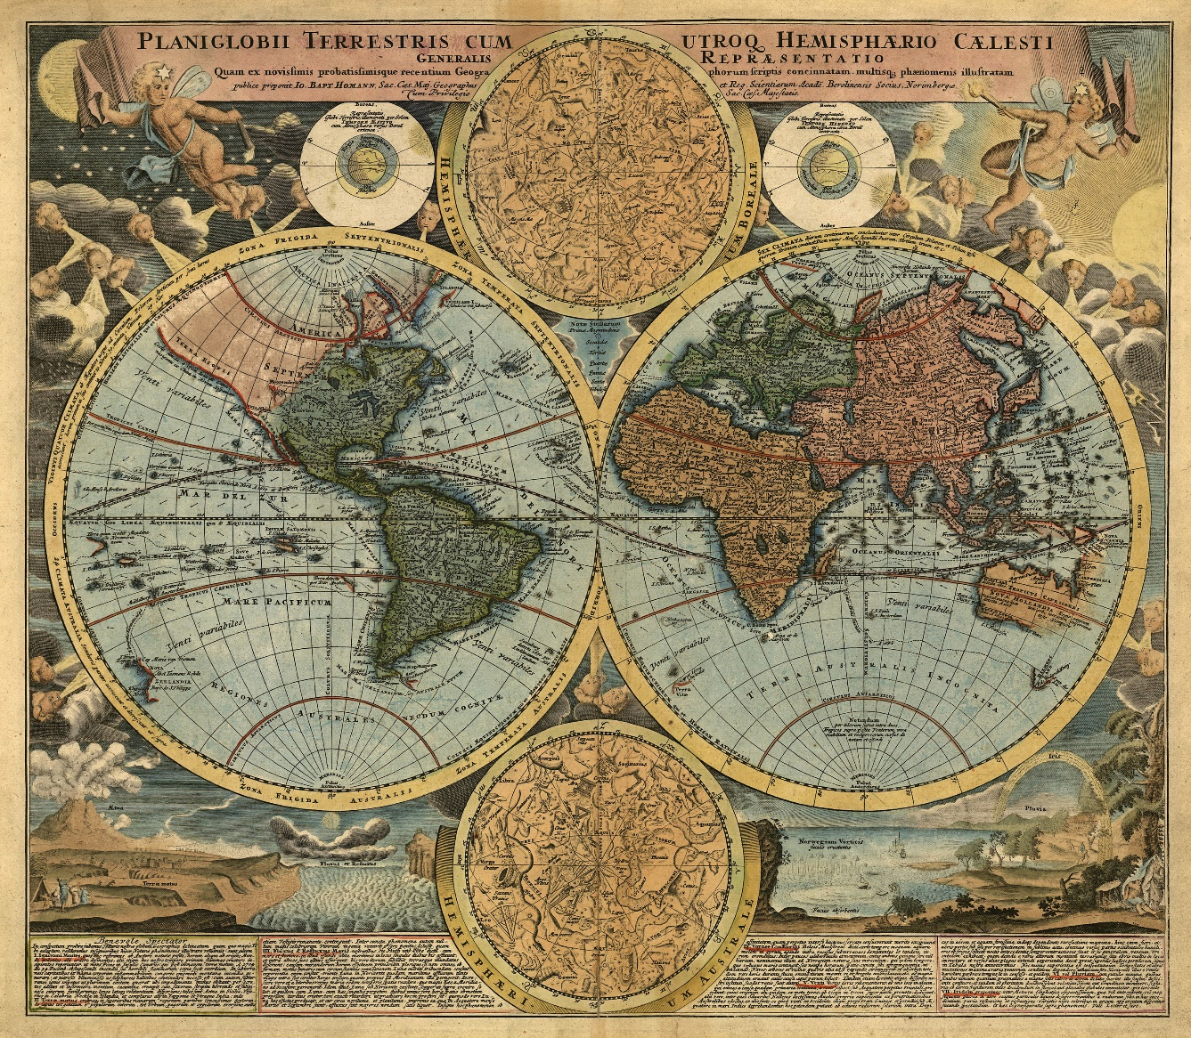
DEMO Understanding the World with F#

Slide 6
Fsharp.org
YWL about F# culturally: as a technology and community and consultants
YWL create a project with F# in Visual Studio
F# interoperates seamlessly with C#
YWL that the Visual F# Power Tools exist
How to find them
YWL that F# has consultants, profit, training, commercial ecosystem, you can hire
YWL to use the F# REPL in Visual Studio
YWL how to reference FSharp.Data and make web request for JSON data
You can also use JSON.NET, WebClient, … from F#
YWL about the type providers in FSharp.Data
You look at the JSON type provider in particular, and how to use it to consume a service that provides JSON data
This is not XML literals in VB
Along the way… YWSee some of the interactive charting options available in F#
They are similar, we will be using Foogle (produces HTML), there’s also FSharp.Charting and others. They are all open source, you can contribute to them
YWL two key technologies for F# + Azure: FSharp.Azure and MBrace
YWL that FSharp.Azure is a set of type providers for F# + Azure Storage (Tables, Blobs, Queues)
YWL that MBrace = cloud { … } = F# code directly via the REPL on ’00s of cores on Azure
cloud { … } OMG , Autoscale, Mbrace, Brisk, Open source
YWL that it is simple to create a new Mbrace cluster on Azure

Slide 7
Questions?

